Slide 1
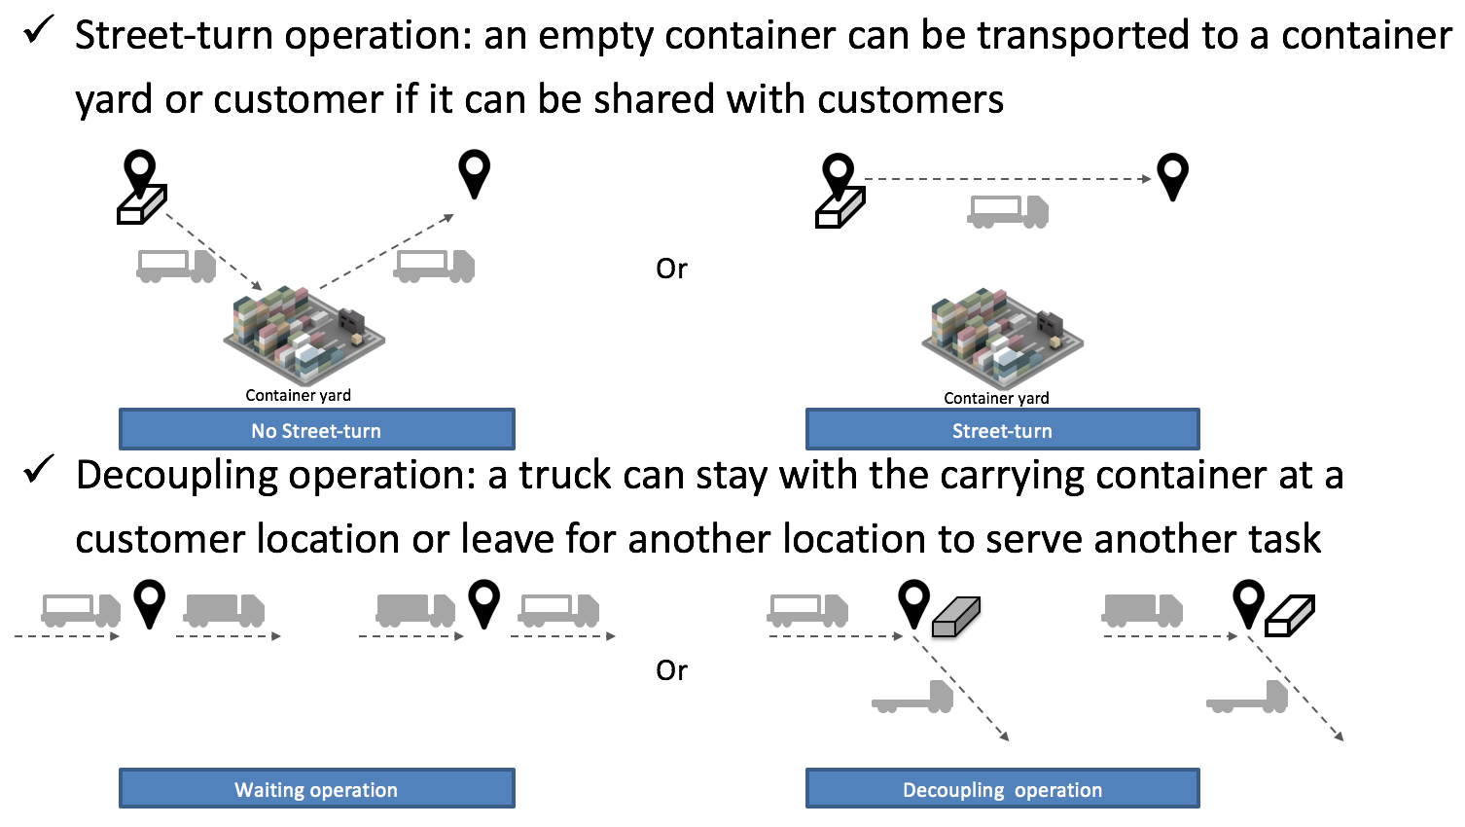
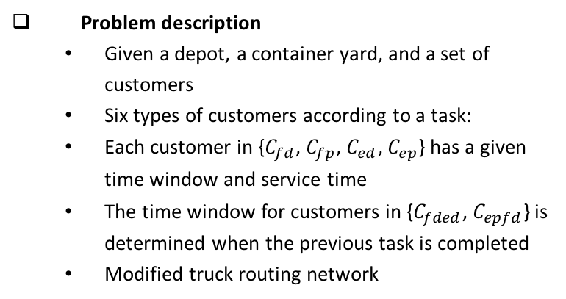
Local Container Truck Routing Problem with its Operational Flexibility
Kyungsoo Jeong, Ph.D. Candidate
University of California, Irvine
Local container truck routing problem
  Increase the efficiency of container movement and reduce the operation cost of a trucking company
  Plan daily truck routes for pickup and delivery of fully-loaded and empty containers
  Consider two flexible operations in truck routing and scheduling:
Problem description
  Given a depot, a container yard, and a set of customers
  Six types of customers according to a task:
  Each customer in {$C_{fd}$, $C_{fp}$, $C_{ed}$, $C_{ep}$} has a given time window and service time
  The time window for customers in {$C_{fded}$, $C_{epfd}$} is determined when the previous task is completed
  Modified truck routing network
  A decision is made at the route construction level by considering time constraints
Mathematical Formulation
  am-TSPTW
  Minimizes the weighted sum of the number of trucks used, total distance traveled and total truck operation time
  Synchronization constraints between time window for consecutive tasks
  A decision is made at the route construction level by considering time constraints

Slide 2
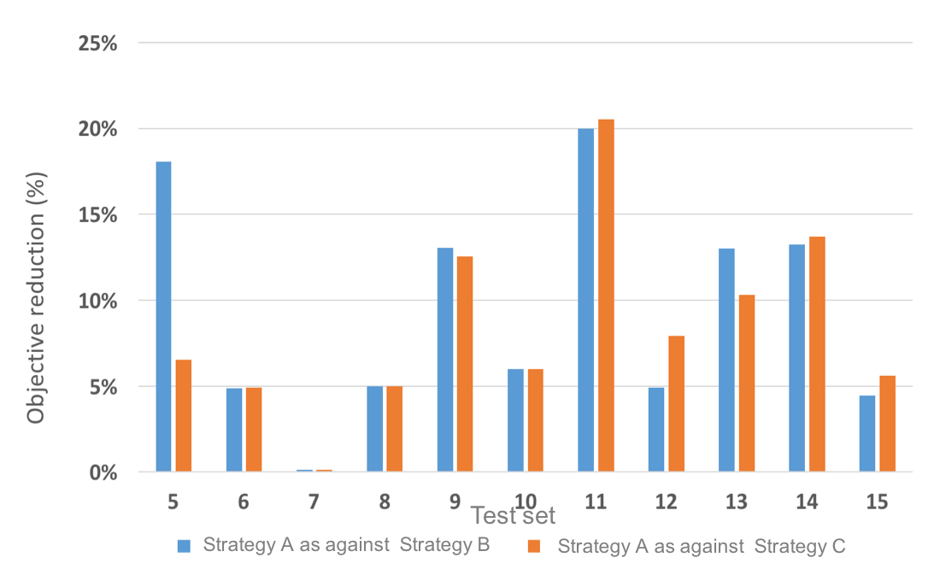
Two-phase Heuristic Approach
  Coded in Python
  Insertion heuristic to generate a feasible solution
  Variable Neighborhood Search (VNS) to improve the current solution
  Feasibility Check algorithm
VNS algorithm
  Neighborhood operators: Intra- and Inter-route Insertion, Swap, 2-opt, Double-insertion, and inter Route reduction
  Perturbation: four inter-route operators and route reduction
  Local search: four inter-route and four intra-route operator were used in random order
Numerical Test
  Randomly generated test instances
  Evaluate the performance of the proposed heuristic algorithm
  Gurobi (ver. 6.0.1) were used for the comparison
  The algorithm found better solutions than the solver within a relatively short time
  Optimal routes with two operations can reduce total travel distance and total operation time compared to the other strategies
Objective reduction rate of the proposed problem

